Slide 1
Face Tracking System
By: Amaneet Pal Singh Benipal, Yash Pund, Varad Desai

Slide 2
Problem Statement
In today's technologically advanced world, the ability to develop systems that can autonomously track and interact with human subjects is becoming increasingly important.
The objective of this project is to design, develop, and implement an Autonomous Face Tracking System with hardware limitations. This system should be capable of real-time face detection and tracking using OpenCV techniques.
And to keep track of people's identities in public places for security reasons only.

Slide 3
Introduction
This project uses live feed, face detection, processing the live image and classification to track faces.
There are two predominant approaches to the face recognition problem:
Geometric (feature based)
Photometric (view based).
Except for these many different algorithms were developed, three of which have been well studied in face recognition literature, they are:
Histogram of Oriented Gradient(HOG) and Linear Support Vector machine(SVM).
Principal Component Analysis using Eigenfaces(PCA)
Linear Discriminant Analysis,
Elastic Bunch Graph Matching using the Fisherface algorithm

Slide 4
Literature
Literature Review | Description
Performance and Accuracy | Evaluating accuracy and performance of Python libraries vs. commercial methods under varying conditions.
Speed and Efficiency | Investigating speed and efficiency for real-time or high-throughput applications.
Robustness to Variations | Assessing how well methods handle variations, including low-quality images, occlusions, and diverse faces.
Privacy and Ethical Considerations | Comparing privacy and ethical considerations between Python libraries and other solutions.
Compatibility and Integration | Evaluating compatibility and integration with existing systems, databases, and APIs.
Scalability | Investigating scalability for processing a large volume of data in real-time.
Adaptability and Customization | Assessing adaptability and ease of customization in Python libraries and other methods.
Cross-Domain and Cross-Modal Recognition | Examining support for cross-domain and cross-modal recognition capabilities.
Continual Learning | Evaluating the ability to adapt to new data and recognize new individuals without full retraining.
Cost and Accessibility | Comparing cost-effectiveness and accessibility, including licensing fees and hardware requirements

Slide 5
Research Gap
Technique | Description | Key Points
Face Recognition through CNN | Utilizes Convolutional Neural Networks (CNNs) to learn features directly from facial images. | Deep learning approach, requires substantial labeled data for training, high accuracy potential, captures complex features.
Eigenfaces | Technique using Principal Component Analysis (PCA) to extract and represent facial features. | Linear dimensionality reduction, struggles with complex features, computationally efficient for large datasets.
Fisherfaces | Builds upon Eigenfaces by maximizing class separability in feature space. | Attempts to improve inter-class separation, can perform better than Eigenfaces in some scenarios.
PCA (Principal Component Analysis) | Linear dimensionality reduction technique used in Eigenfaces and Fisherfaces. | Reduces feature dimension while preserving variance, fundamental component of Eigenfaces and Fisherfaces.
SVM (Support Vector Machines) | Classification algorithm used for various purposes, including face recognition. | Requires labeled training data, good for classification tasks, can work well with appropriately chosen features.
Haar Cascades | Object detection method using Haar-like features for rapid face detection. | Quick face detection, suitable for real-time applications, less accurate compared to some other methods.
Face Recognition Library | Pre-built software tool often using various techniques including CNNs for face recognition. | Offers user-friendly APIs, pre-trained models, convenient integration, suitable for developers with varying expertise.

Slide 6
Objectives
The objective of creating a face tracking system using Python and Arduino is to develop a technology that can autonomously track and follow human faces in real-time. This system combines computer vision techniques with hardware control to achieve the following objectives:
1.Real-Time Face Tracking: The system aims to use computer vision techniques to continuously detect and monitor human faces in real-time video feeds.
2. Autonomous Camera Control: It involves automating the movement of a camera or sensor to follow the tracked faces, ensuring that the subjects remain within the camera's frame.
3. User Interaction: This system can provide options for users to interact with it, such as adjusting tracking parameters or selecting specific faces of interest.
4. Hardware-Software Integration: It combines Python software for computer vision with an Arduino-based hardware setup to control the camera's movements, achieving a seamless interaction between the two components.
5. Practical Applications: The system can be used in various practical scenarios, such as video conferencing, security surveillance, and content creation, where automated face tracking adds value and convenience.

Slide 7
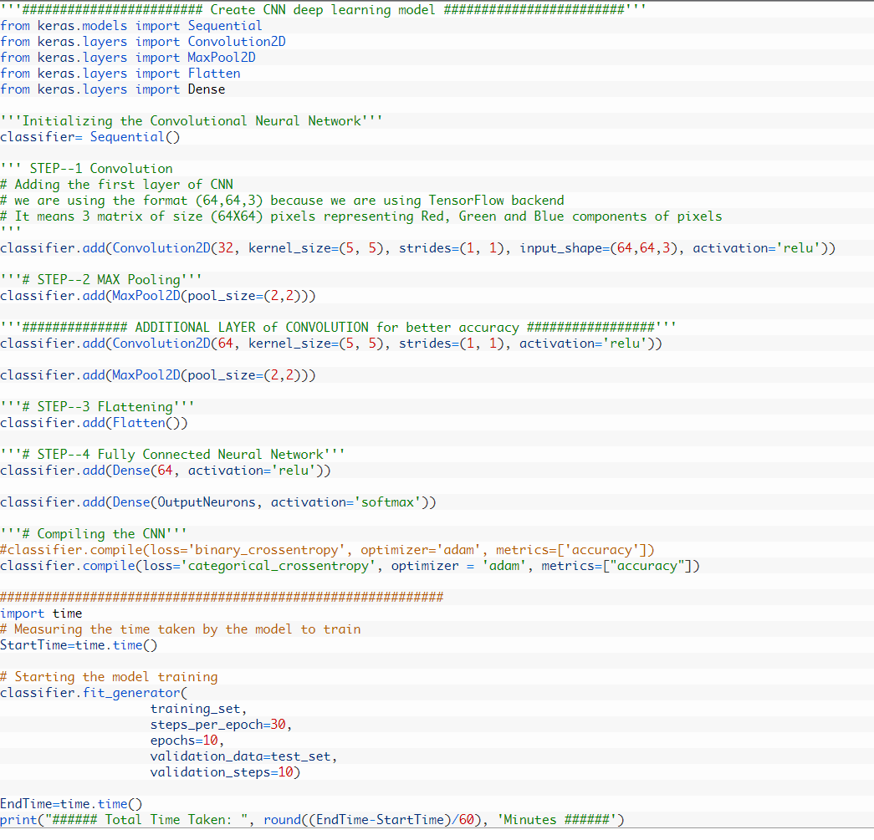
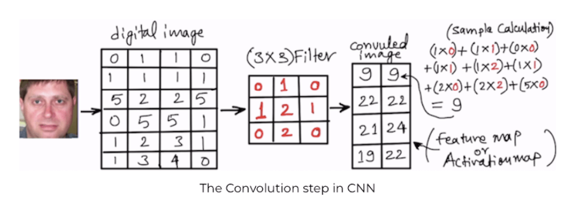
Face Recognition through CNN

Slide 8
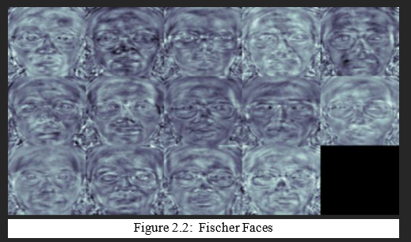
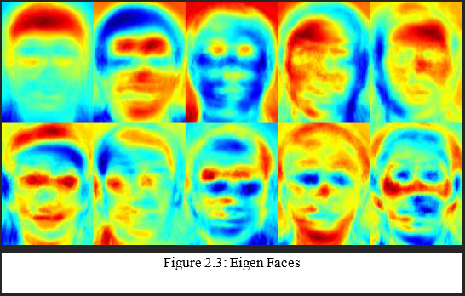
EigenFaces(PCA) & Fischer Faces

Slide 9
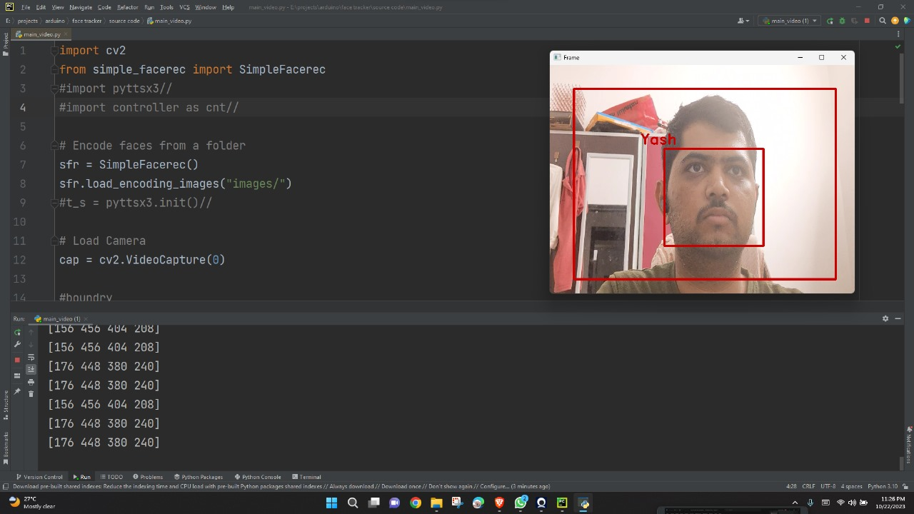
Face Recognition Library

Slide 10
Methodology
Hardware Setup: Using microcontroller and servo motors for tracking mechanism
Software Setup: The required software's are Arduino IDE, Python 3.0, including all necessary modules and packages such as OpenCV, Serial for communication with Arduino.
Programming: Write the Arduino sketch to control the servos/motors based on the input received from the Python script. Use the OpenCV library to capture video frames from the webcam/camera module. Implement face detection using a pre-trained deep learning-based model like a Convolutional Neural Network(CNN).
Integration: Establish communication between the Python script and the Arduino by sending data over the serial connection. In the Python script, send the calculated servo control values to the Arduino for adjusting the camera's orientation based on the detected face's position.
Final: After fine calibration and testing, the software and hardware shall run successfully and the model would be ready to execute.

Slide 11
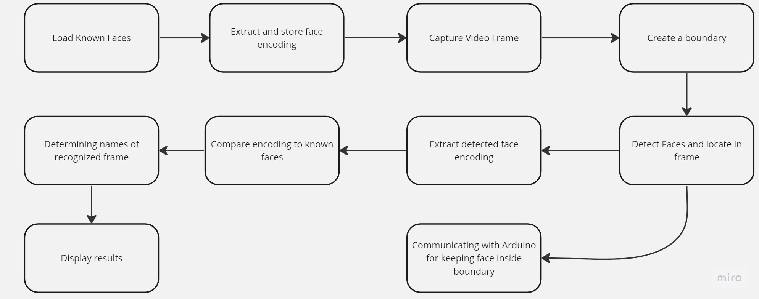
Flowchart

Slide 12
Conclusion
Face recognition and tracking are integral components of computer vision that enable the identification, authentication, and monitoring of individuals based on their facial features.
Face recognition uses deep learning to match faces to known individuals, finding applications in security and personalization.
Face tracking involves real-time monitoring of facial movements and expressions, enhancing experiences in AR, VR, and video conferencing.
While these technologies offer significant benefits, privacy concerns and ethical considerations must be carefully addressed

Slide 13
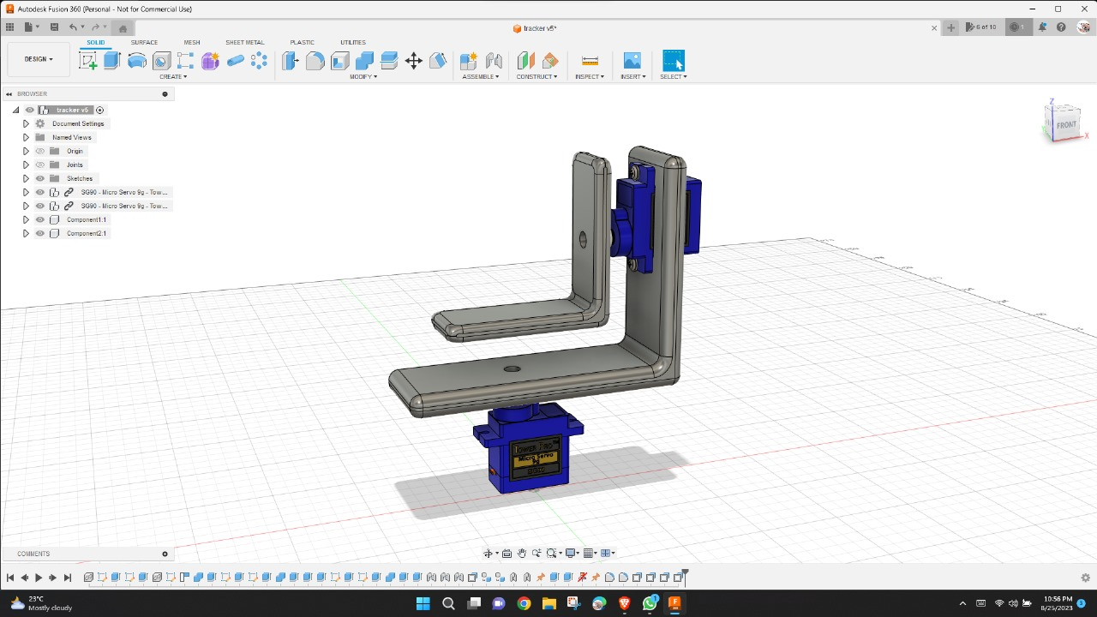
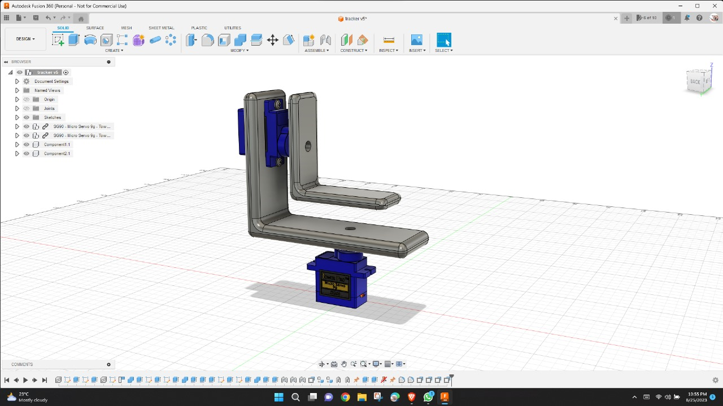
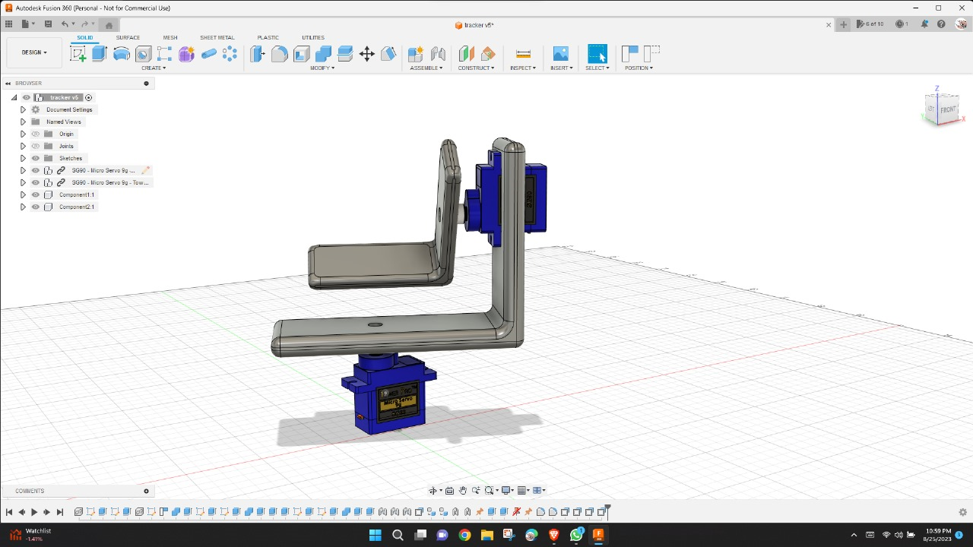
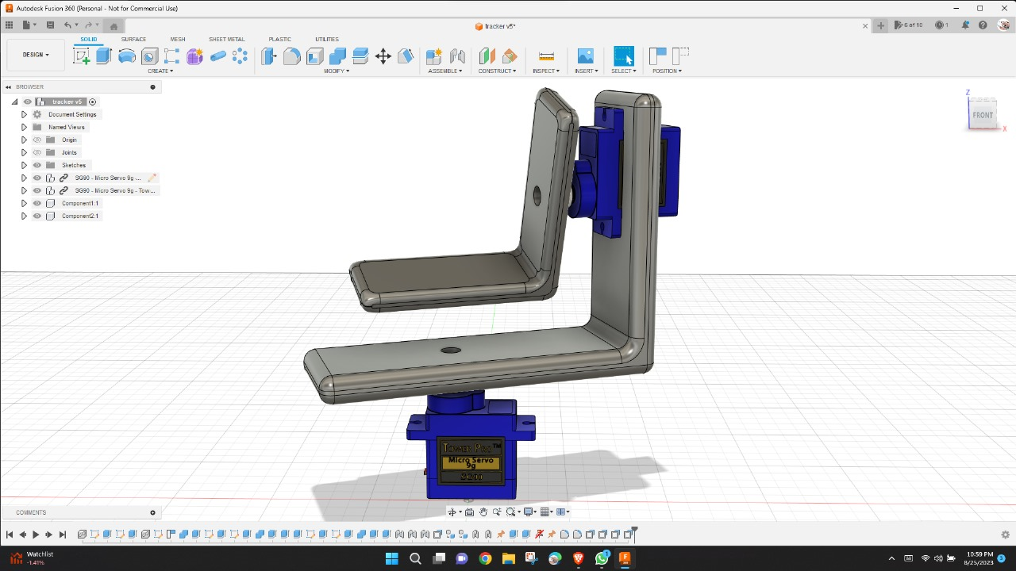
PROJECT GALLERY

Slide 14
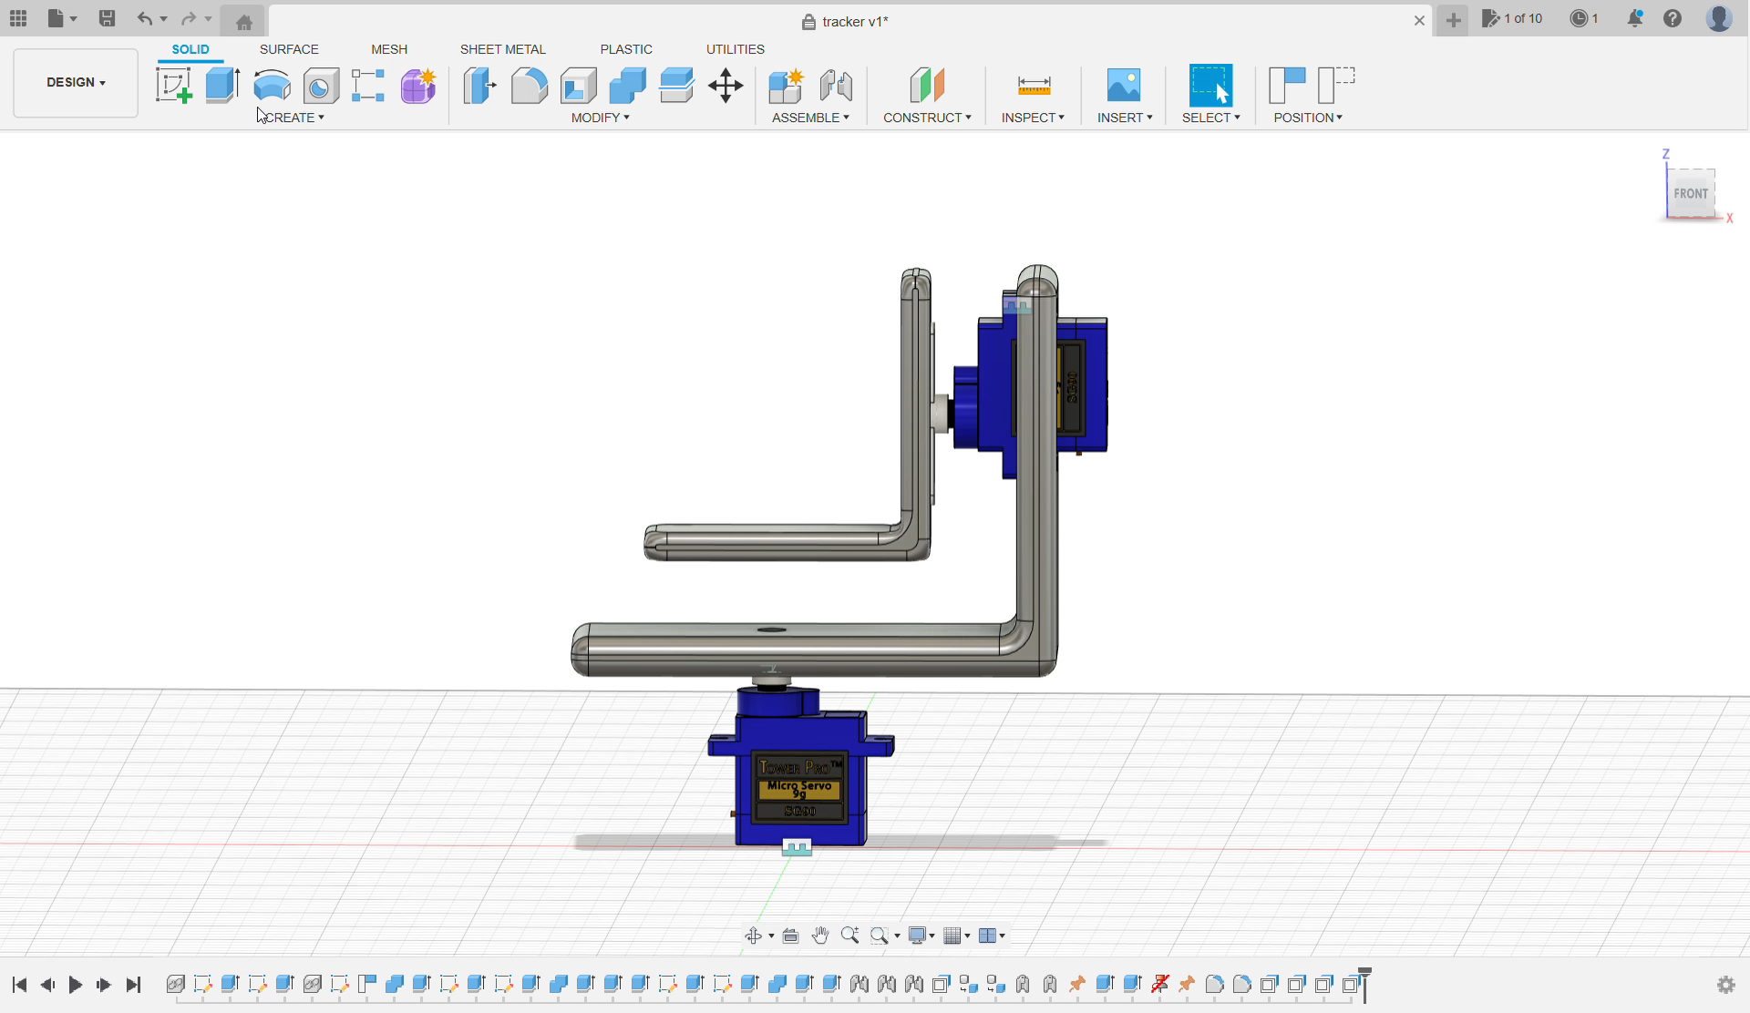

Slide 15
References
Github:
https://github.com/ageitgey/face_recognition
https://github.com/Chando0185/led_controller_python_arduino
Website:
https://thinkingneuron.com/face-recognition-using-deep-learning-cnn-in-python/

